Slide 1

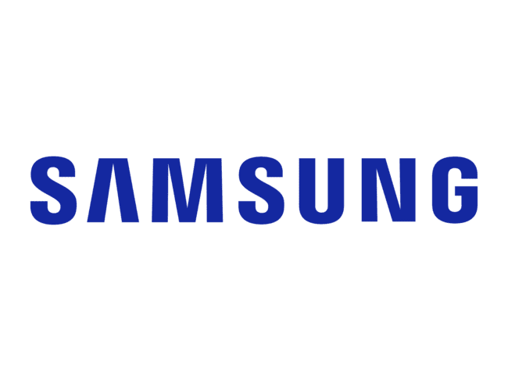




Team Guardians of the GALAXY
Debosree Roy
Ranit Chatterjee
Drisha Paul
Himalaya Wellness
ABG
Nestle

Slide 2









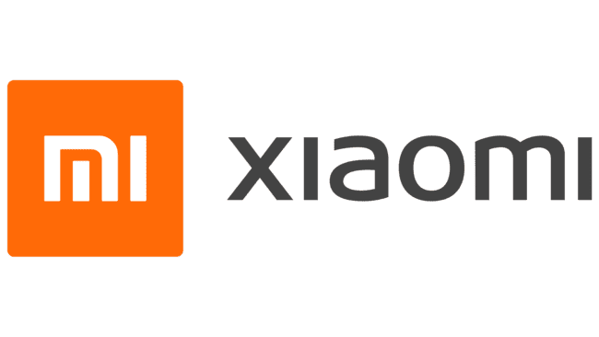






The new consumer wants to purchase an experience, not just a product…
We have done a primary survey across 89 consumers in the age group 18-24 and we have identified distinct consumer personas and what they want from in store experience
Brand
What they do
Consumers want the ease and the convenience of online shopping but don’t want to miss out on the experience
Exclusivity of in store
Unique SonyStyle scent, especially to attract female consumers
Importance
The brand conscious
Loves the Samsung brand, determined to buy from the store, wants the latest product
Knowledgeable service
Large screens showcasing latest products & tech.; use of bright & colourful displays
Unique experience
The researcher
Will test all the products, needs best salesperson to guide them
Brand engagement
Stores in landmark locations
Minimalist interiors with stores divided into 4 sections
Extends the product designs into the environment
Products displayed like museum: to educate
Incorporate nature in stores for ambience
The lock sound association
The unsure experimental
Wants to try multiple products, feel and touch them before deciding
Ease of payment
Convenience
Sight and audio are most widely used. Consumers feel connected to brand once they touch it
The pleasure shopper
Enjoys shopping from the store as it acts like detox,
Personalization
The online shopper
Walks into the store rarely, afraid that might be overwhelmed
What consumers find appealing
50%
Knowledgeable and helpful sales associate
The store hopper
Checks and compares across store. Retention is key to make them purchase
41%
Ability to use app in store to browse
38%
Offers click and collect services, self-service checkout
Ability to try immersive experiences
PWC report
amps the engine sounds through the car speakers, even when the audio system is turned off
Pre purchase experience to develop awareness
24%
Post purchase experience to maximise user exp
4-5 senses recalled linked to 59 % brand loyalty
What Samsung is doing currently
Samsung King’s cross outlet
It has been designed as a playground and community space where customers can discover and experience the best of Samsung’s tech
Products engineered to generate heat upon application
360
Sensory
comm
During purchase experience to maximise perception of value
Delivering more than what meets the eye
Transforming NRF retail with sensory experiences, partnering with HARMAN & Martin Lightning for scents and sounds.
SOURCE: HOLLIS, N. (2007)
Pain points for the 18-24 age group consumers (in India)
Samsung Interactive Display
It is linked to Bluetooth based location services and can greet customers with personalized messages when they enter the store
Computer vision used for seamless no contact shopping experience, personalized recommendations
Taste, smell and hearing have a greater impact on loyalty
Lack of customization
Salesperson not skilled enough
Outdated store ambience
Lack of interactive displays
Samsung Windows all in one Kiosk
Enables out-of-stock orders and speeds up self-checkout, aiding retailers in better inventory mgt. with interactive displays.
50 %
consumers use smartphones in store for comparison view live product reviews before making a purchase
Inference:
40 %
Consumers are influenced by sponsored social media advertisement
Integrating sensory experiences into brand strategies for enhanced visual merchandising, improving the customer experience in stores and further to strengthen brand loyalty
SOURCE: PWC report

Slide 3
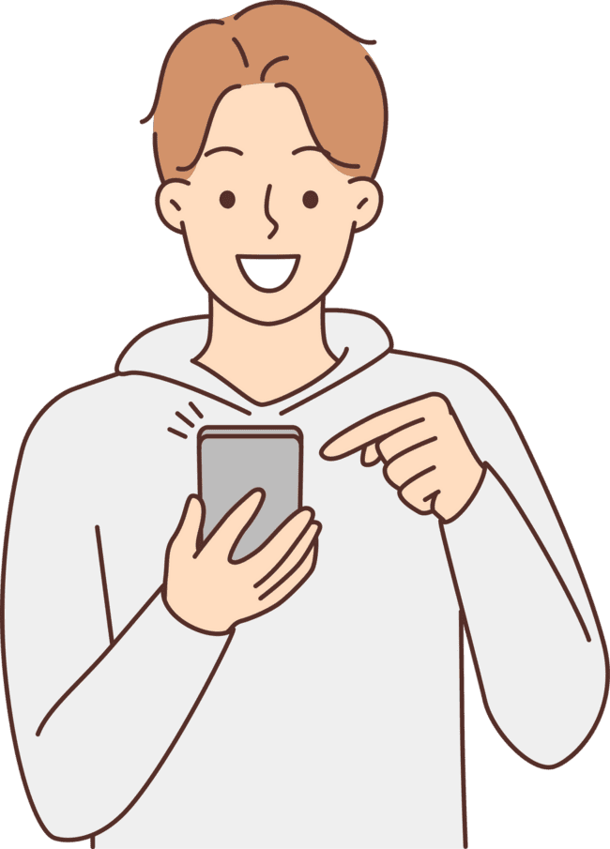

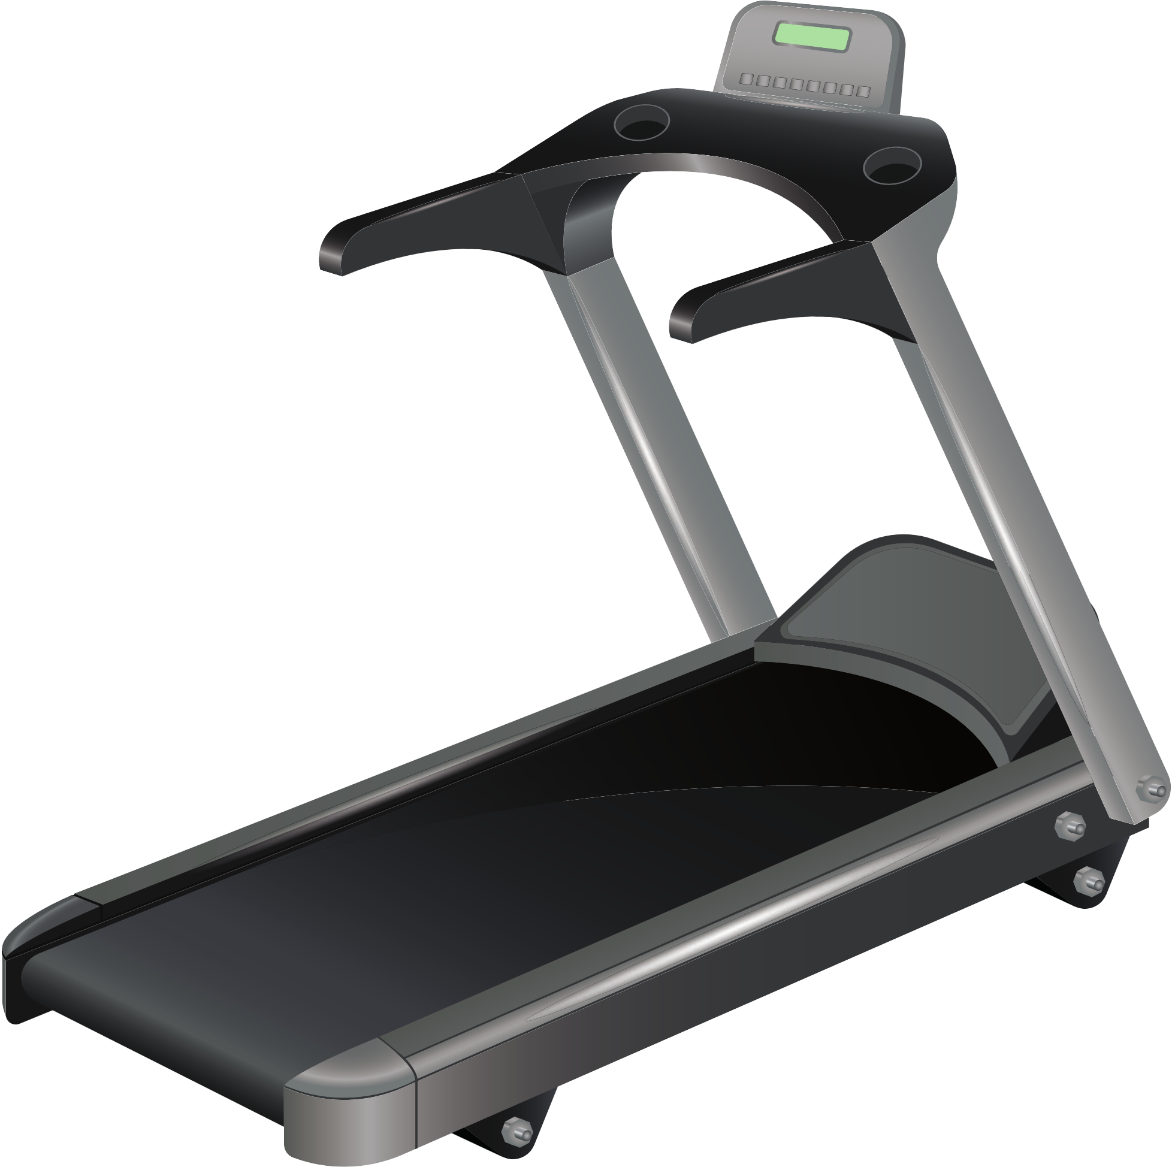

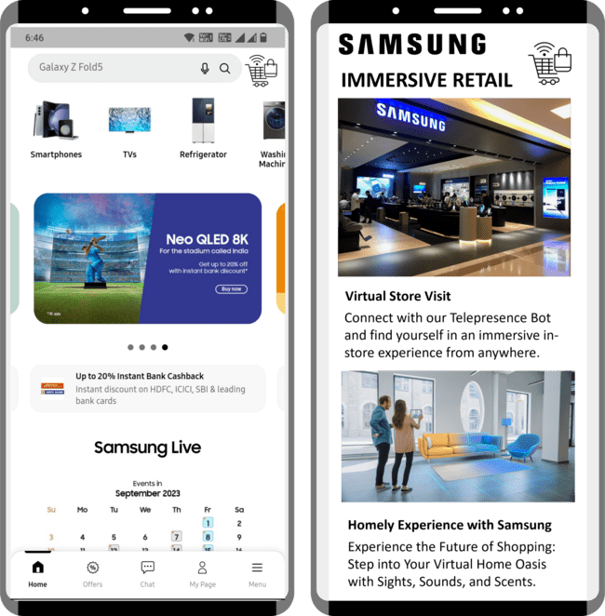


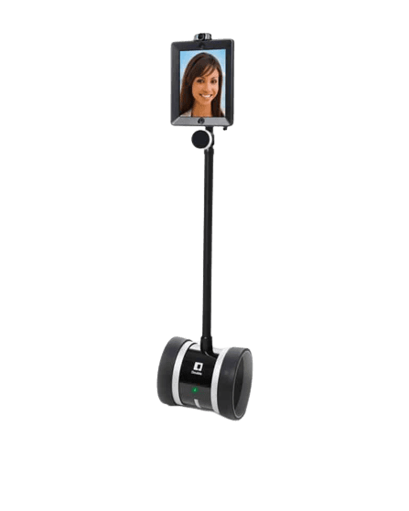
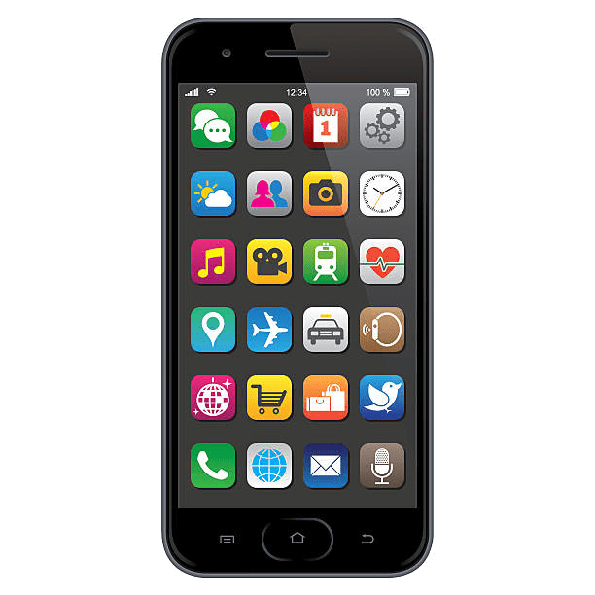
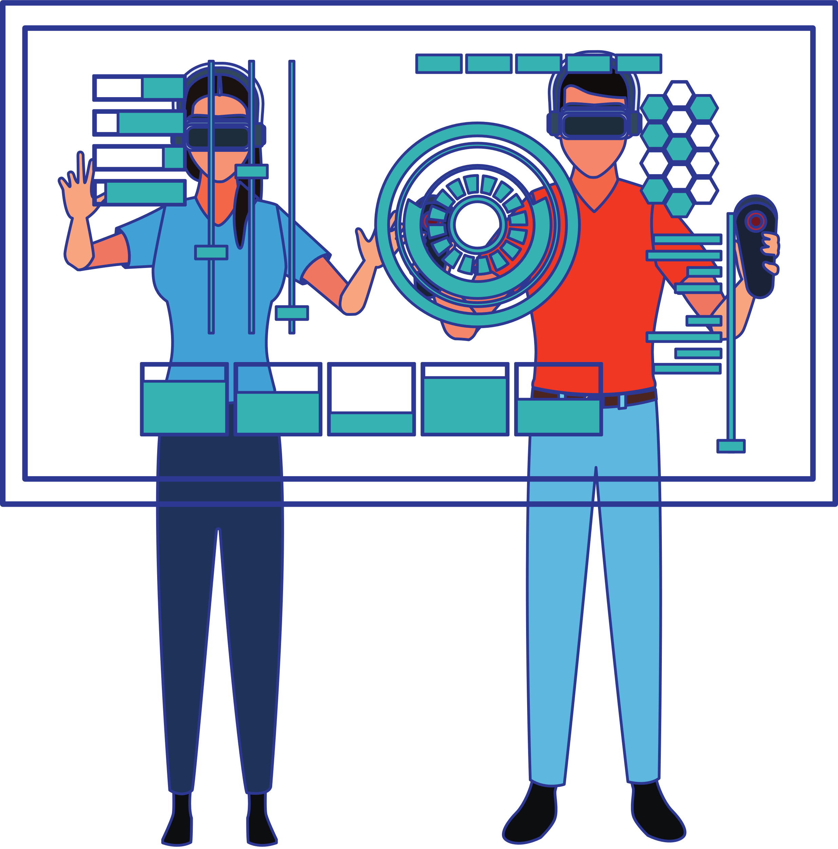


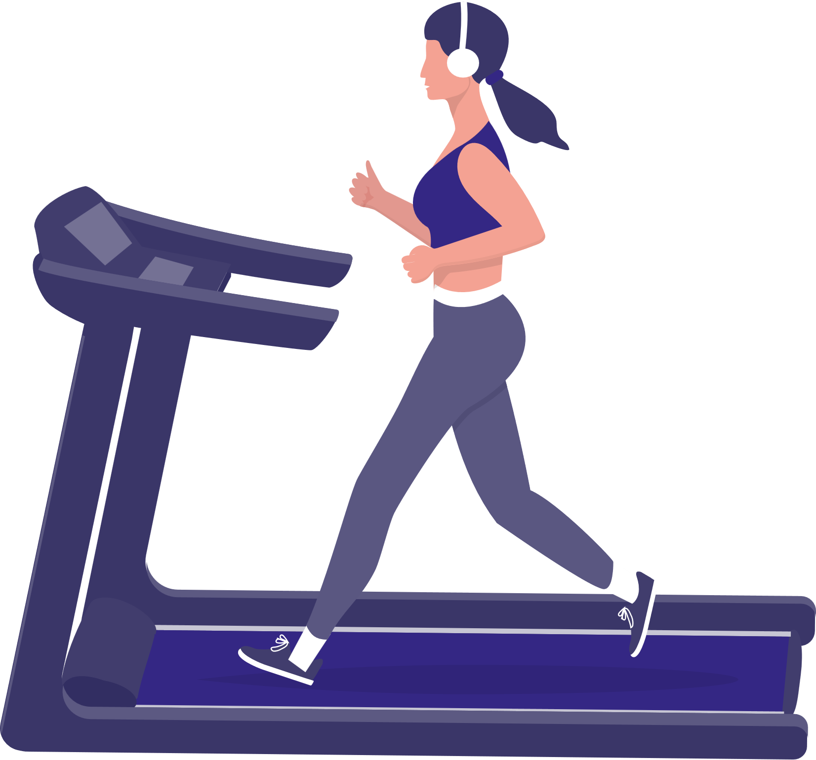


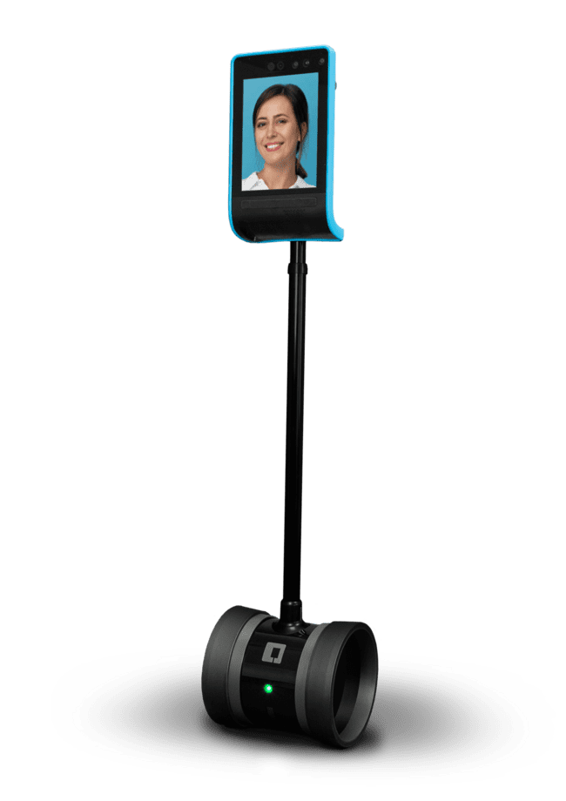
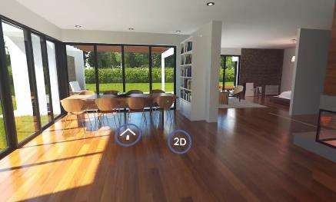
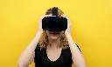

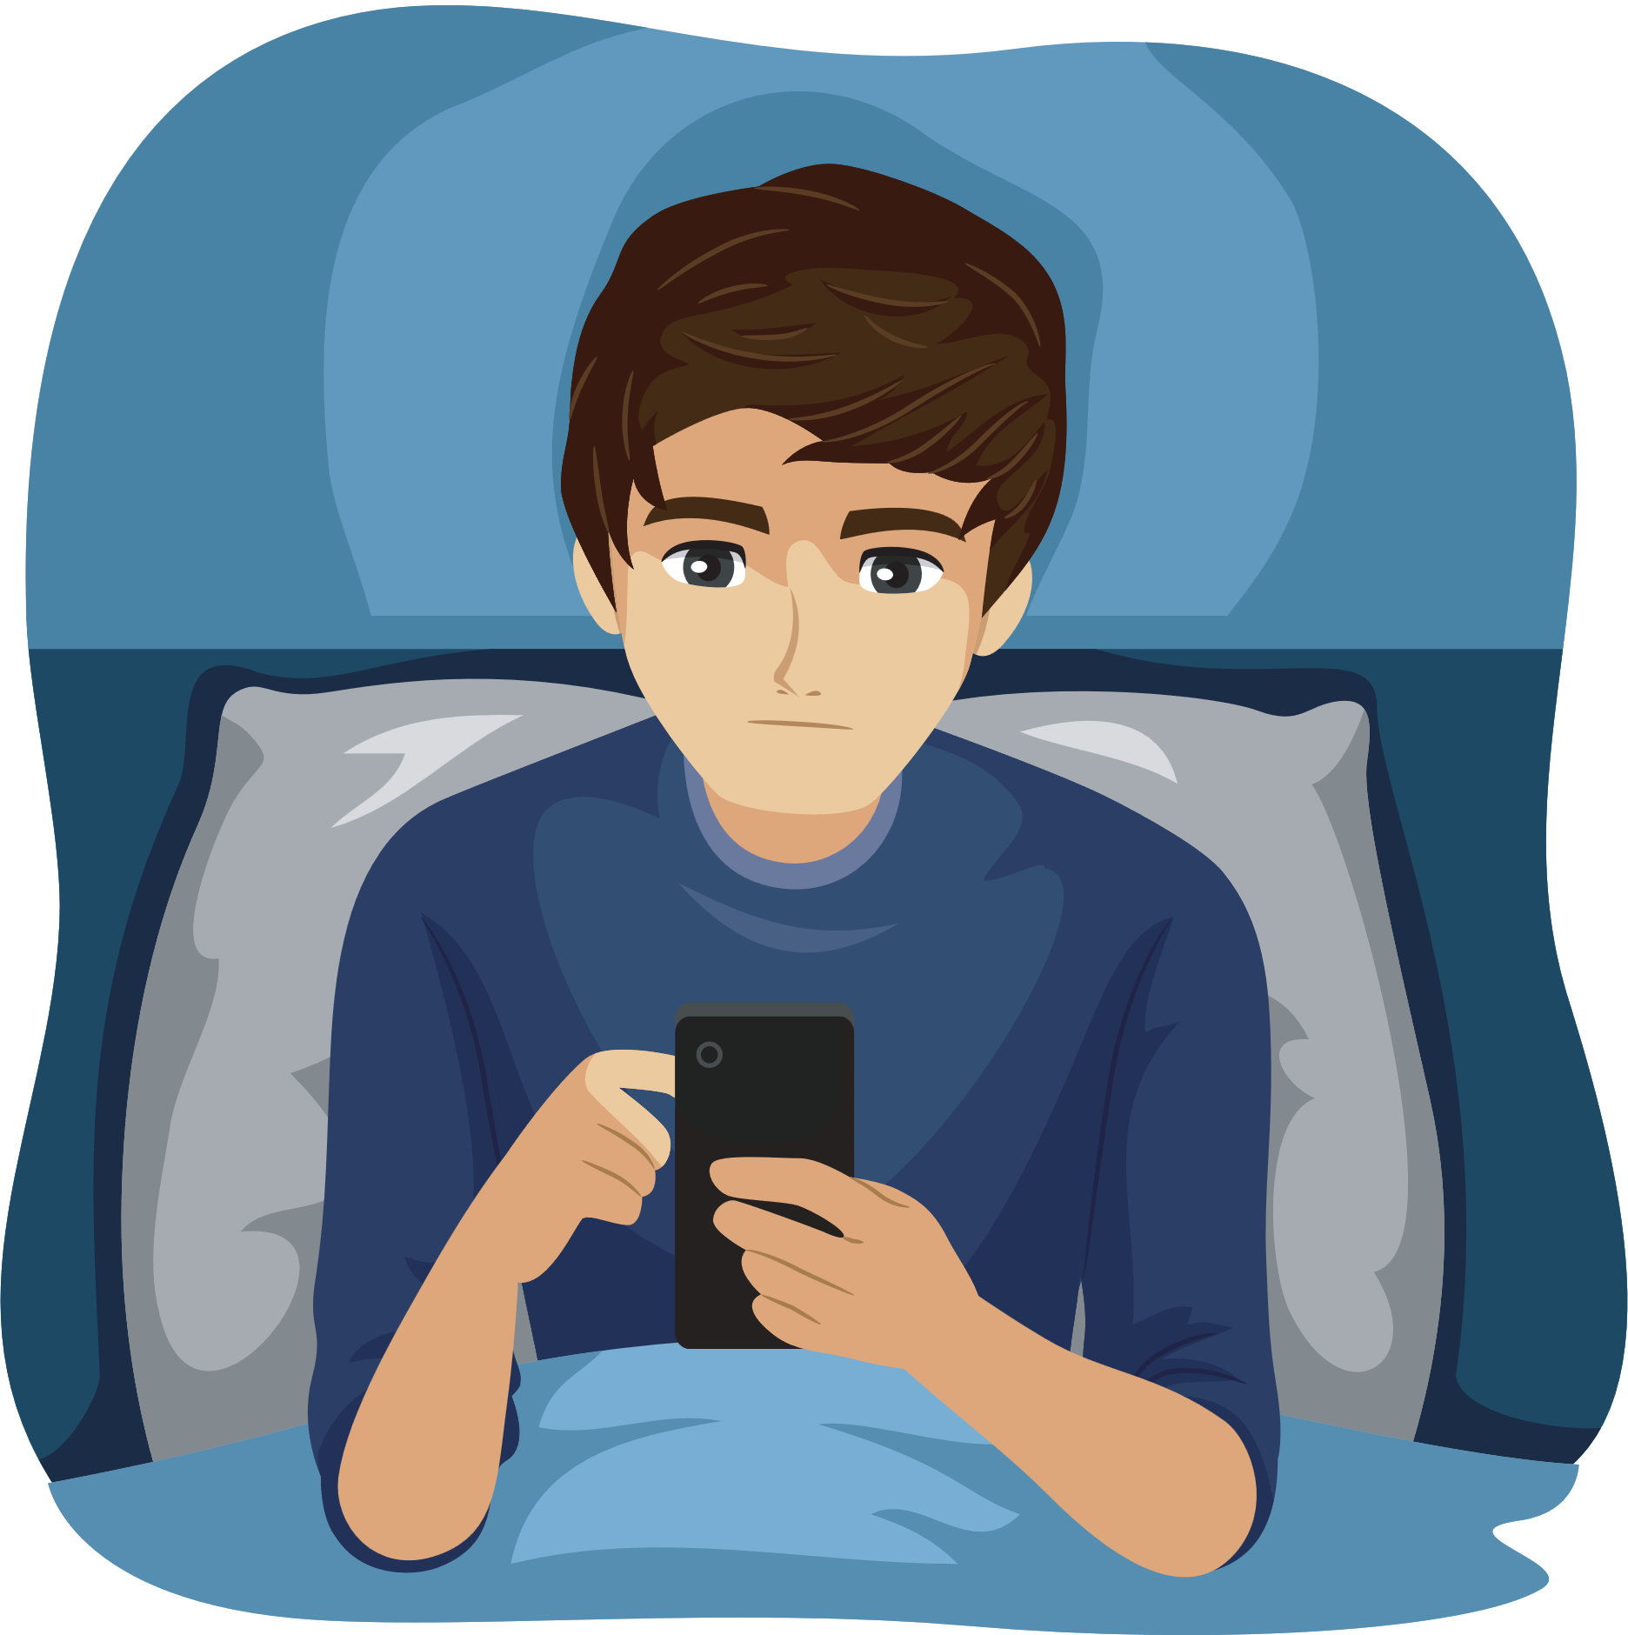
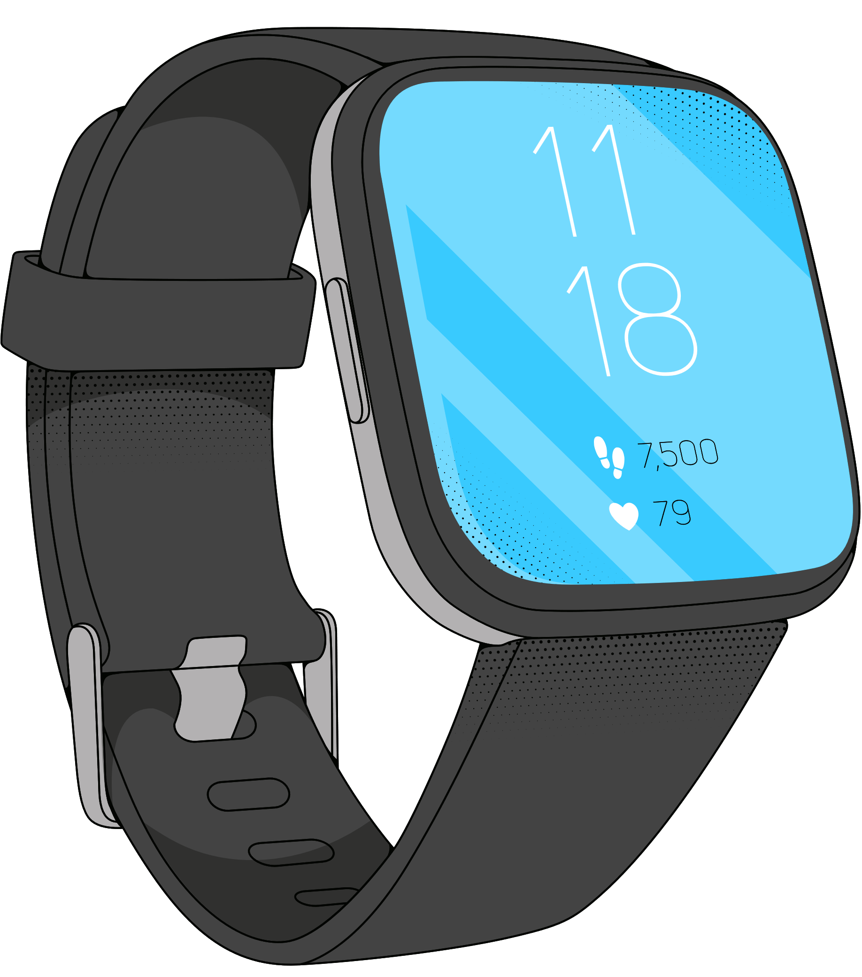

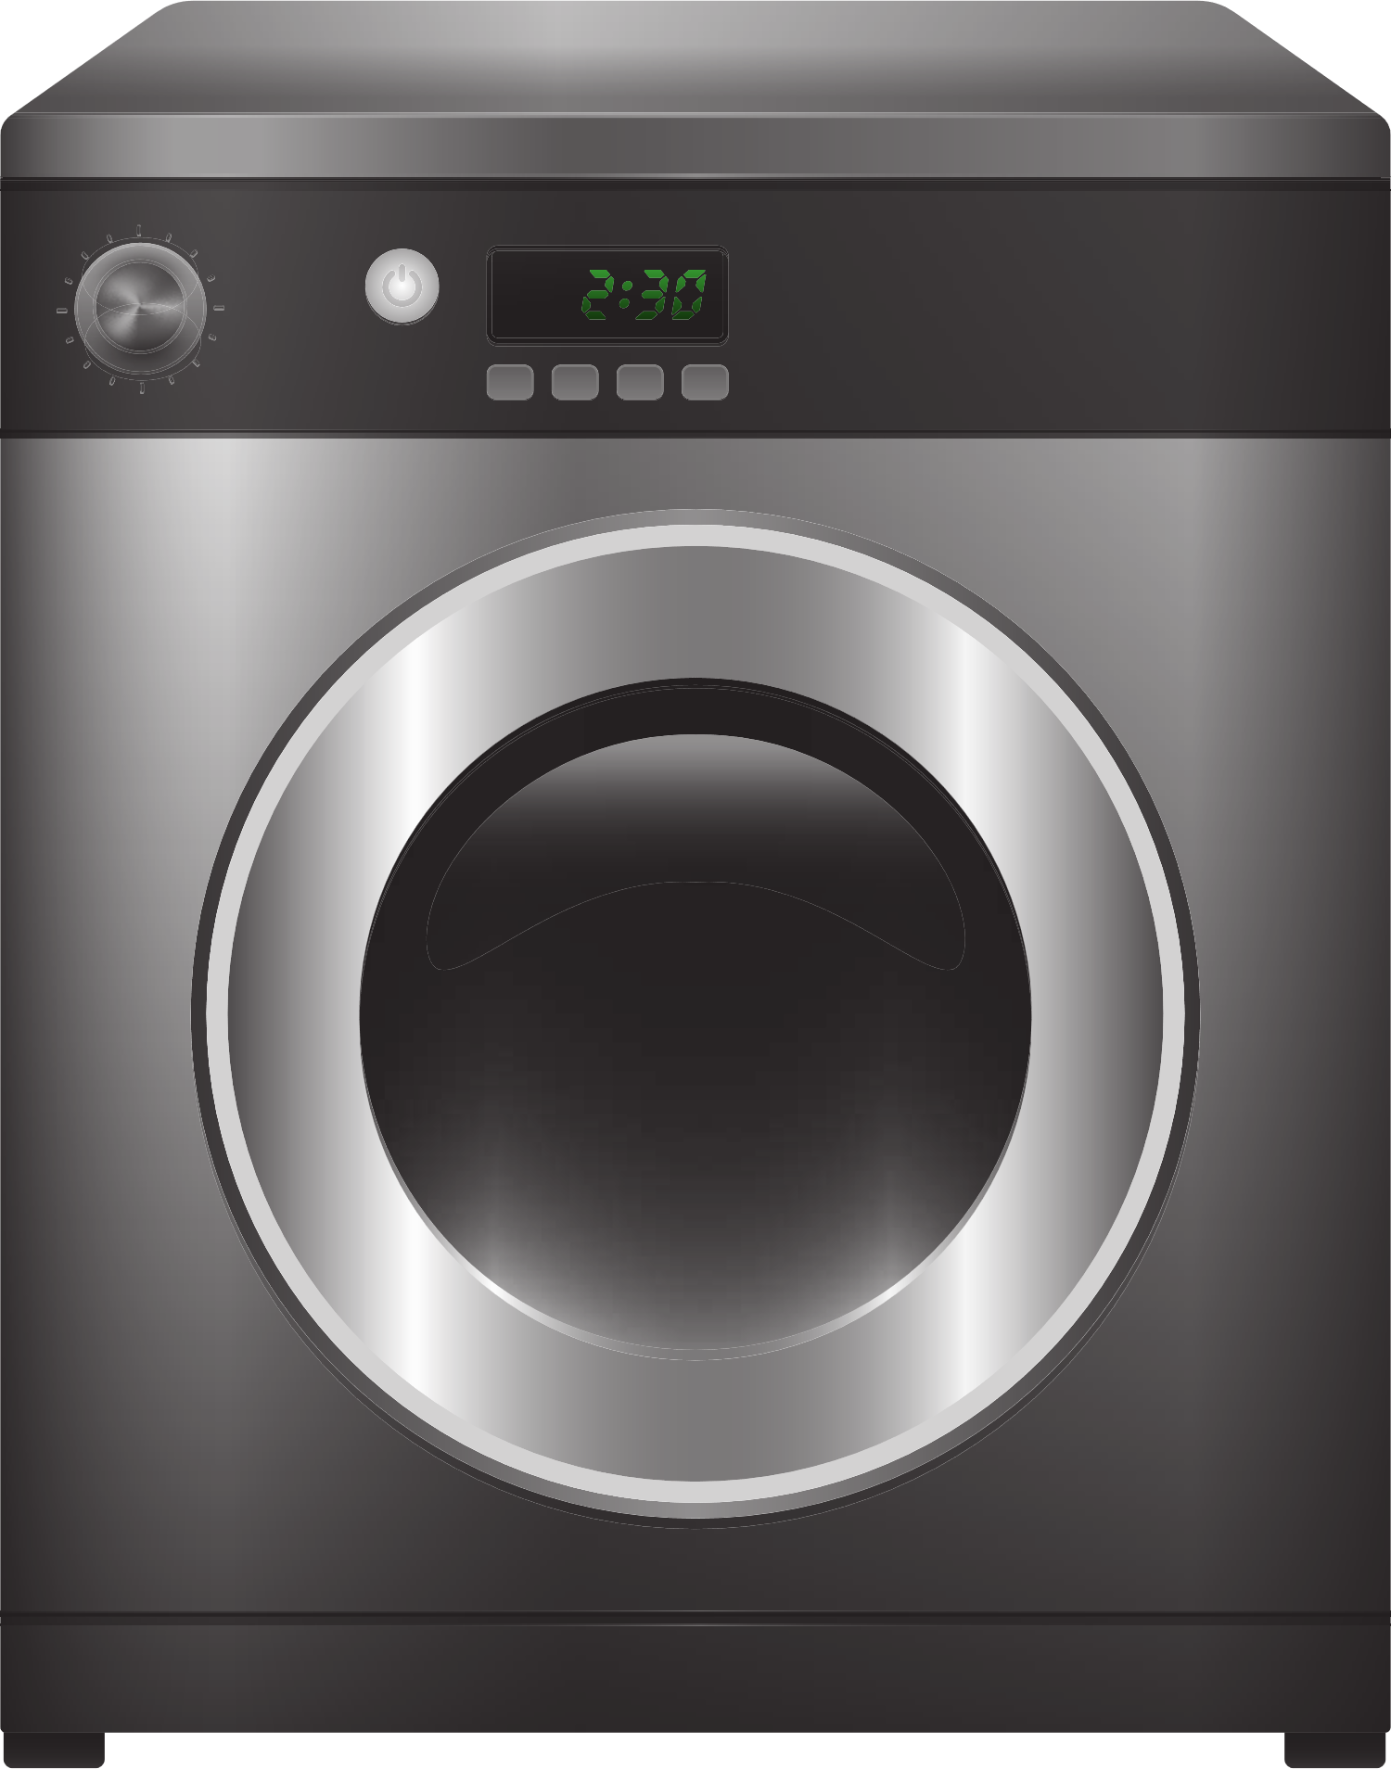
















Reimagining Retail with Multi-Sensory Omni-Channel solutions…
Samsung store from the comfort of your home
A part of your home in Samsung Stores
Make Samsung your Fitness Partner
New Immersive Retail section in Website/App
Potential customers visit Immersive Retail section on Samsung Website/App & book a Virtual Store Visit
Potential customers visit Immersive Retail section on Samsung Website/App & book a Homely Experience
The portal asks the users to share images of home interiors
Potential customers entering Samsung Stores can discover a complimentary cardio challenge waiting for them
Immersive
Retail
Section
Store Professionals rendering the interiors in a dedicated zone of the Samsung Store using VR software
Generate Awareness of Multisensory Retail in the banners
Stores ensure customers get an immersive experience of their home in Samsung stores by incorporating familiar household sounds such as soft background music, appliance noises, and the ambiance of conversations
Introduction of common scents like freshly brewed coffee, clean laundry, and subtle floral fragrances
Customers are patched through to
Double 3 Telepresence Robot
Human Store Assistants guide the Digital Twin (Telepresence Bot) of the Customer through product demonstrations
Financial Analysis
Utilizing VR technology and integrating fragrances and sounds, the stores have the power to provide customers with an immersive sensation of jogging through picturesque hills and serene beaches.
Customers get an immersive experience of the store from the comfort of their home. Allows an experience for family as well
With Samsung Smartwatches, stores can record ECG data and reward customers with personalized store vouchers on select products
Partner with Double robotics to avail the Telepresence robots
Collaborate with Matterport for transforming physical spaces into digital twin models
Leverage AR View tech through collab. With IKEA & Pepperfry
Collaborating with health insurance companies to provide premium schemes based on ECG data from Samsung devices.
Partner with ABG, ICICI life insurance
The implementation strategy involves initially introducing these initiatives in 100 pilot stores during the first year and then incorporating them into the next 400 stores in the second year.

Slide 4
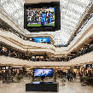
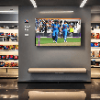
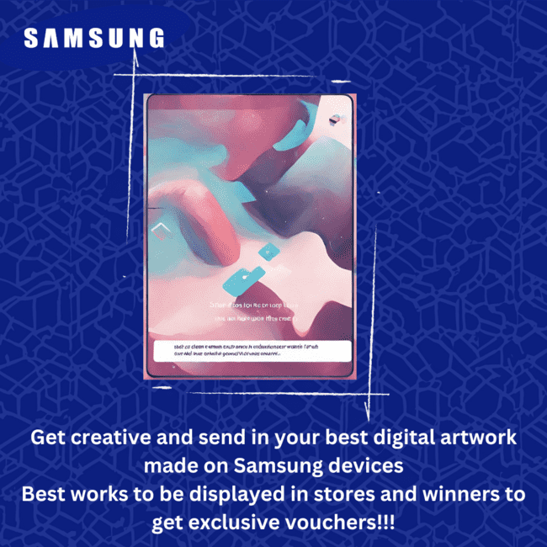
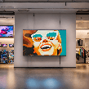
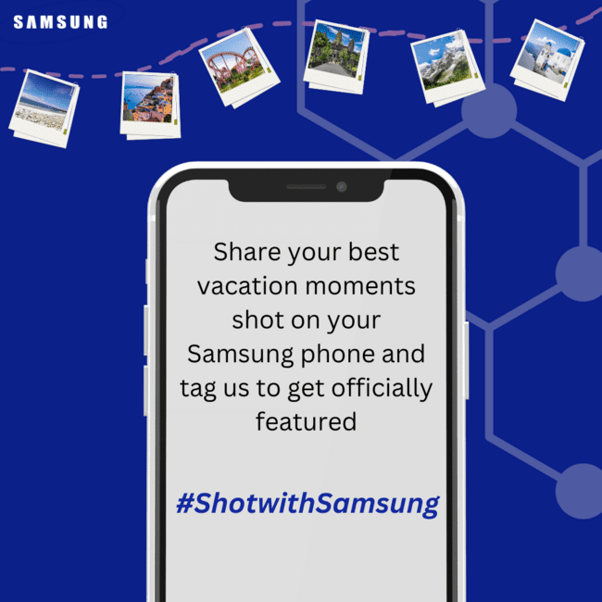

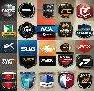

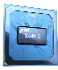
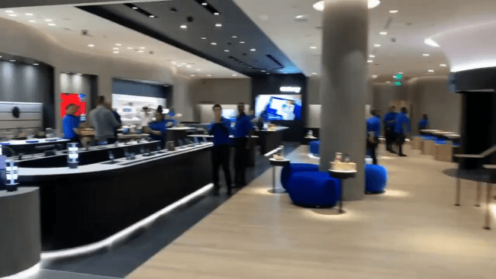






Targeted Multi-Sensory Marketing Campaigns towards the Youth…
87% viewers in the 18-24 age group prefer watching sports on TV and large displays
57% people in the 18-24 age group make digital artworks
Screen se Sports
Setting up Samsung displays (QLED series) and sound systems (MX series) in Malls and in retail outlets for hosting match screenings and other major events
Visits malls to hangout
Collaborate with digital artists and art galleries to engage Samsung users through displaying their digital artwork across avenues, including retail stores
Digital art connoisseur
34.7% of all Instagram users fall in the 18-24 age group
57% people in the 18-24 age group is engaged in gaming
Ask the customers to share their best vacation moments shot on their Samsung phones & cameras, and share using #ShotwithSamsung to get featured on the official stories and displays across malls in between match screenings
Host a 2-minute short nighttime display of the best #ShotwithSamsung moments across the retail stores using the Samsung RU and TU series of curved displays.
Loves travelling
Casual & hardcore gamers
Invite gamers and streamers to try out Samsung’s gaming devices & promote them through their social media, and publicise the brand through sponsoring major gaming events
“The ultimate sensory experience for the next generation”
Solutions at the Confluence of AI & Neuroscience
Ad theme- A young college student walks down the street, looking bored. They see a Samsung Retail Store and stop in their tracks. They enter the store and are immediately enveloped in a sensory symphony, welcomes with the Samsung tune. They are enchanted by the short yet mesmerizing in-store art show. The person explores the latest Samsung products and services, completely immersed in the experience. They leave the store feeling excited and inspired
Our audience, 18-24 years
Neuromorphic Computing & Spiking Neural Networks
Mimics the human brain's structure and functions
SNNs use binary signals (spikes) for communication
Similar to how neurons in the brain use electrical pulses
Applied in Interactive Displays for real-time content adaption in Samsung Stores
Utilize visual, auditory, & haptic sensors to track & respond to user interactions.
Legal & Privacy Concerns
Data Collection & Protection
Informed & Voluntary consent necessary for collecting & sharing customer data
Building the brand loyalty for Samsung
Generative AI
Incorporate the unique Samsung sound with the display of Samsung logo at the end of every advertisements and during breaks between match screenings
In store, play the tune whenever a new customer enters
Data Retention
Establishing storage standards & tenure of retention of personal data
Neuromarketing
Application of neuroscience principles to study how consumers' brains respond to marketing stimuli.
Techniques
Leverage Generative AI to create immersive VR scenes, integrate it into VR gear, optimize real-time rendering, and iteratively enhance the experience based on user feedback.
Cross Border Data Transfer
Compliance with DPDP, GDPR & HIPAA acts
To experience how the entrance to a store would feel like, click here
EEG
fMRI
Eye Tracking
Facial Coding

Slide 5
APPENDIX

Slide 6
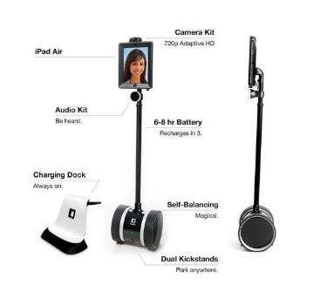


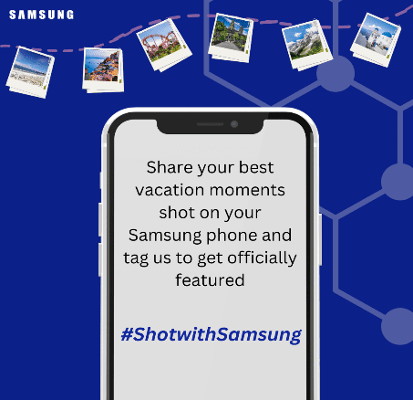
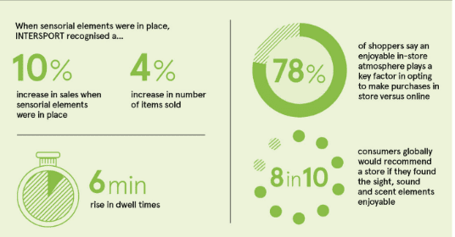
Appendix

Slide 7
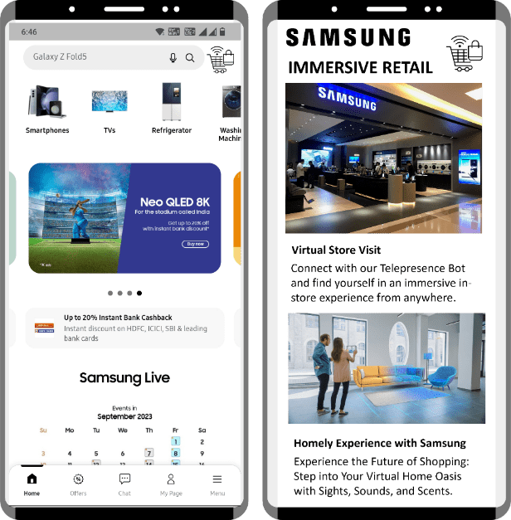
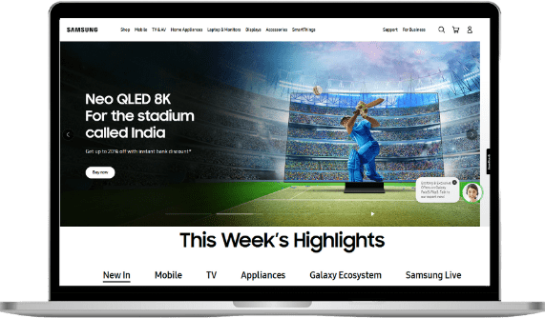


Slide 8
Reference
https://ixtenso.com/retail-marketing/sensory-experiences-increase-in-store-sales.html
http://essay.utwente.nl/95268/1/Konniger_BA_DoubleDegree.pdf
https://hbr.org/2015/03/the-science-of-sensory-marketing
https://www.linkedin.com/pulse/creating-unforgettable-brand-experience-through-das-gupta-she-her-/
http://s3-ap-southeast-1.amazonaws.com/ijmer/pdf/volume11/volume11-issue6(2)/15.pdf
https://www.uschamber.com/co/grow/marketing/five-senses-retail-experience
https://shopventory.com/blog-posts/sensory-marketing/
https://www.sciencedirect.com/science/article/abs/pii/S0022435919300892#:~:text=Sensory%20elements%20are%20an%20important,experiences%20and%20their%20buying%20behaviors
https://www.raconteur.net/sponsored/how-sensory-retail-is-paying-off
https://www.thestorefront.com/mag/3-pop-stores-senses/
https://retailinnovationconference.com/blog/how-brands-are-using-the-5-senses-to-guide-store-experience-design/
https://blog.hubspot.com/marketing/sensory-branding#:~:text=Sensory%20Branding%20by%20Starbucks,they%20walk%20through%20the%20door
https://retailminded.com/5-senses-and-5-reasons-you-need-to-use-them-in-your-store/
https://ixtenso.com/retail-marketing/sensory-experiences-increase-in-store-sales.html

